Slide 1
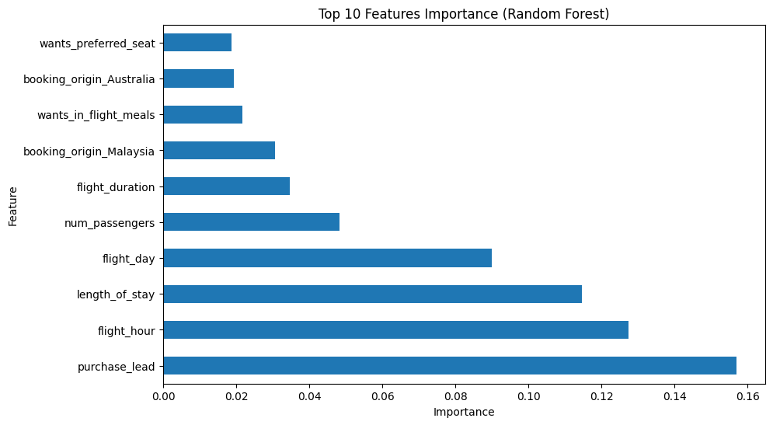
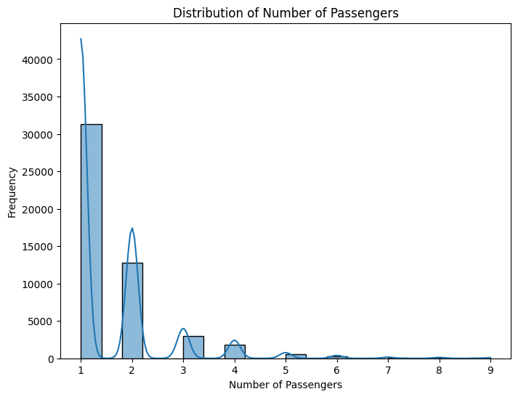
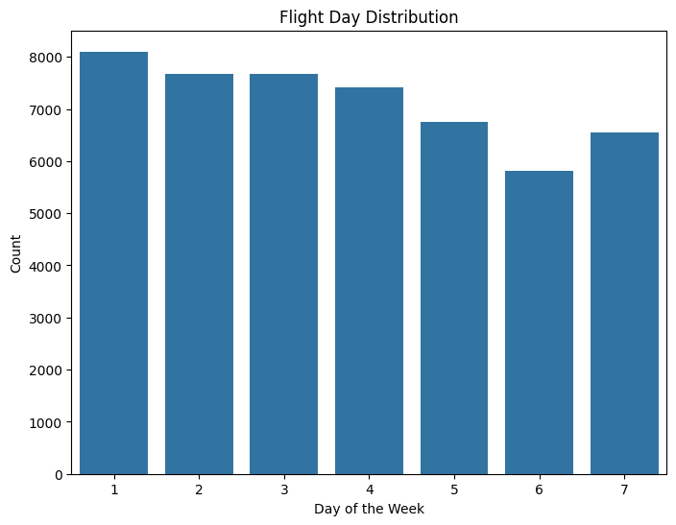
Passenger booking completion chiefly depends on the days between booking and travel, along with departure time, stay duration, and weekday of flight
Most travelers booked solo, with couples being the second most common. Group bookings of three or more were rare.
Departures peak on Monday, diminish throughout the week, and rise again on Sunday.

